Slide 1

Chicago Crime Analysis and Prediction by Deep Neural Nets

Slide 2
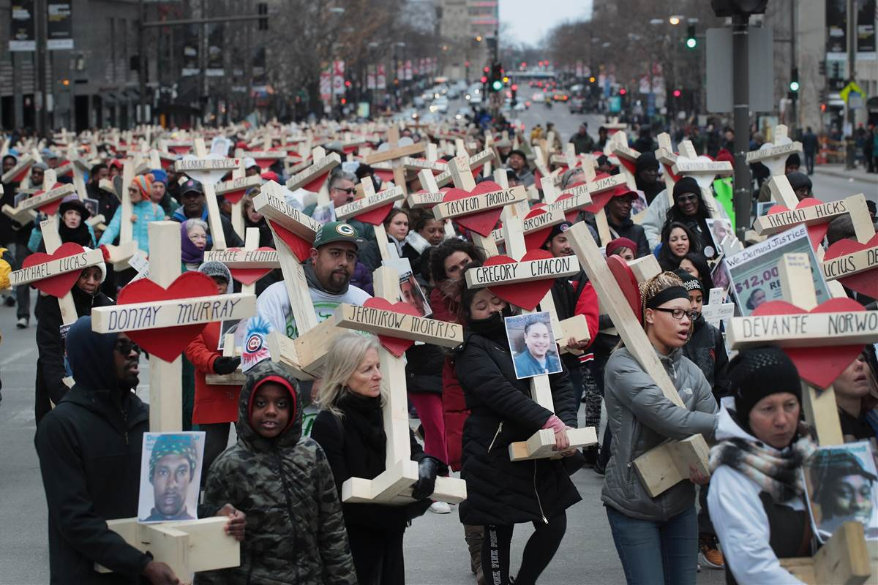
Background
Overall Chicago’s crime rate is higher than the US average

Slide 3

Nearly half of the homicides in the US has been recorded from Chicago

Slide 4
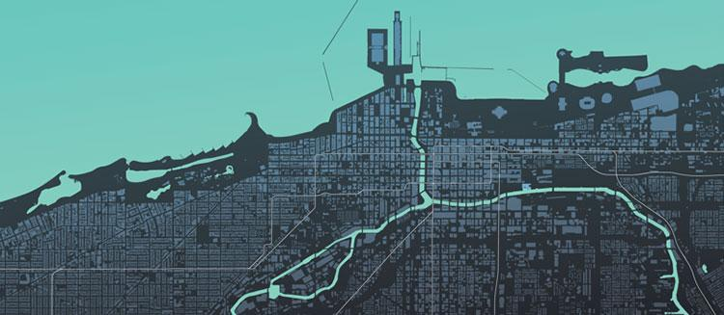
Data Collection

Slide 5
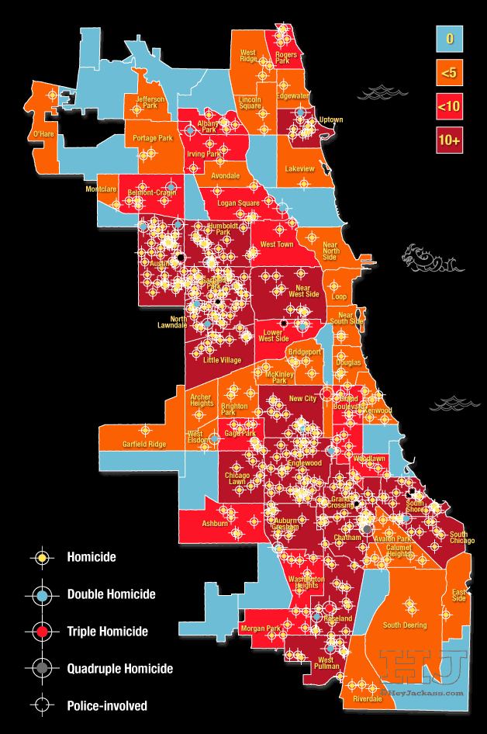

The data set for analyzing Chicago crimes is obtained from City of Chicago official site.
We were able to collect a dataset of 6314567 records and 23 variables containing all the data related to crimes.

Slide 6
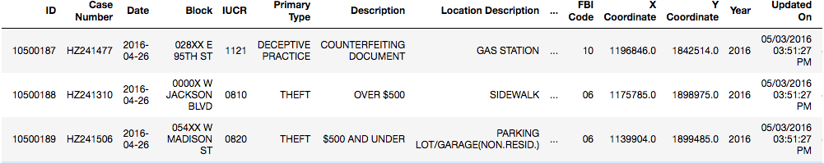
Data Sample

Slide 7

Data Analysis

Slide 8
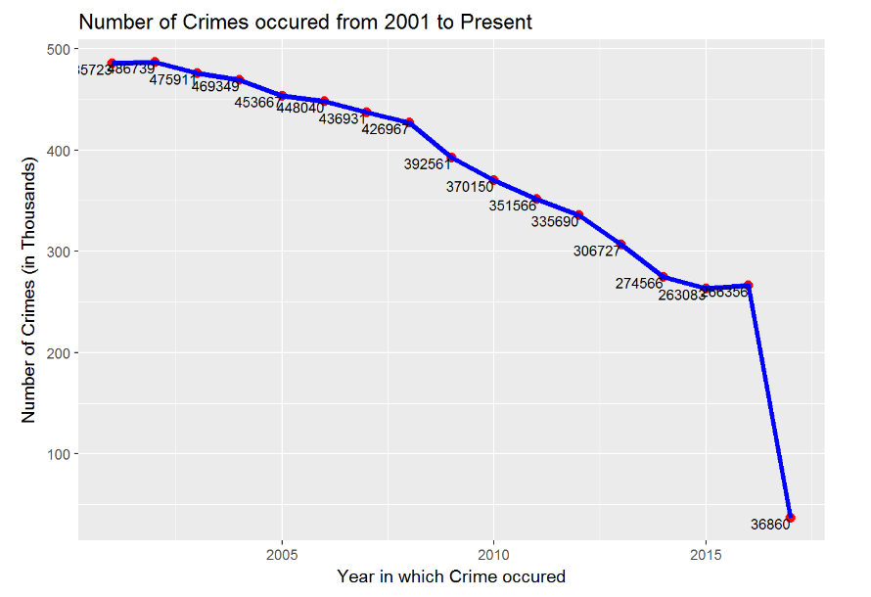
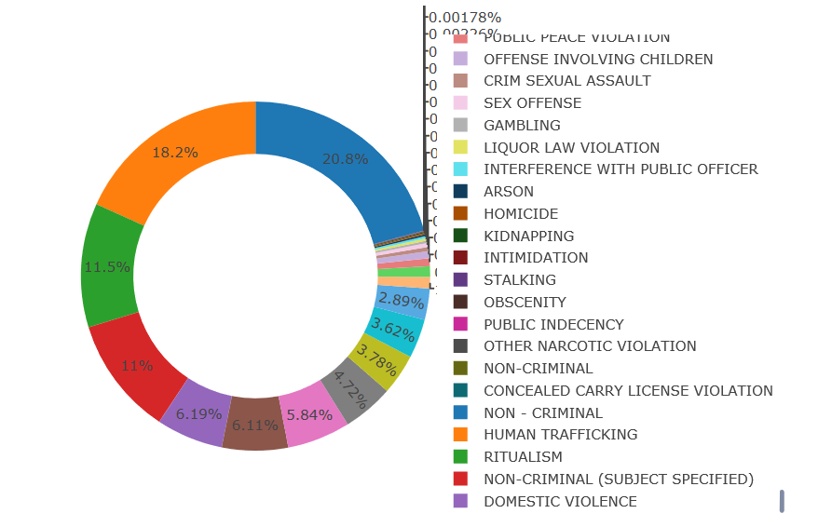
Data Analysis
Interactive Donut Chart to describe Percentage of different types of crime
Trend line depicting Number of Crimes per year (2001 to Present) (Crime versus Year)
This is a donut graph which shows up Percentage of crime for each type of crime. here are 37 types of crime cases. This information will help Chicago Police to make a decision on which of the crime is occurring frequently and also to take more precaution towards that particular crime and reduce it in future.
The Graph Describes Total Number of Crimes occurred in Chicago from 2001 to present (2017). The analysis enables the Chicago Police Department’s Bureau to understand the percentage increase or decrease of crimes over years. This trend line shows that the crime count is gradually reducing and at 2017, as of today we see that only 36540 was found.

Slide 9
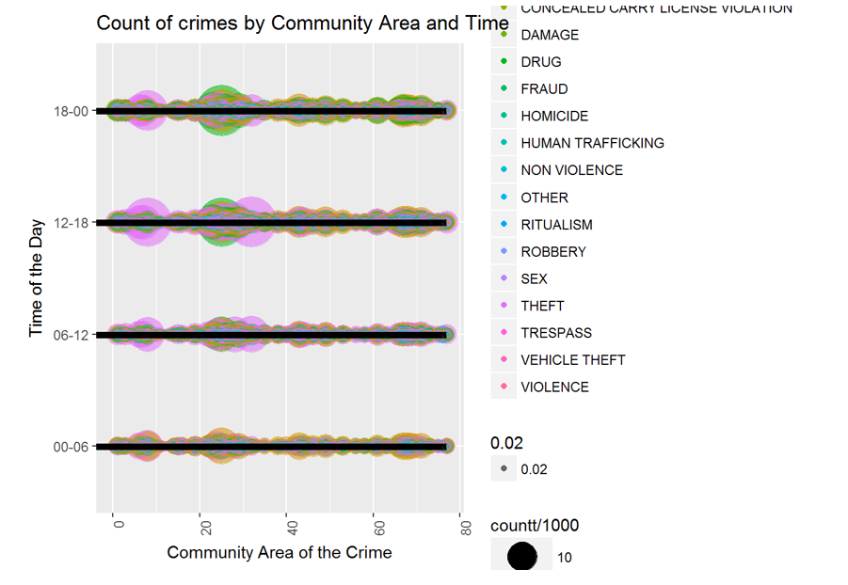
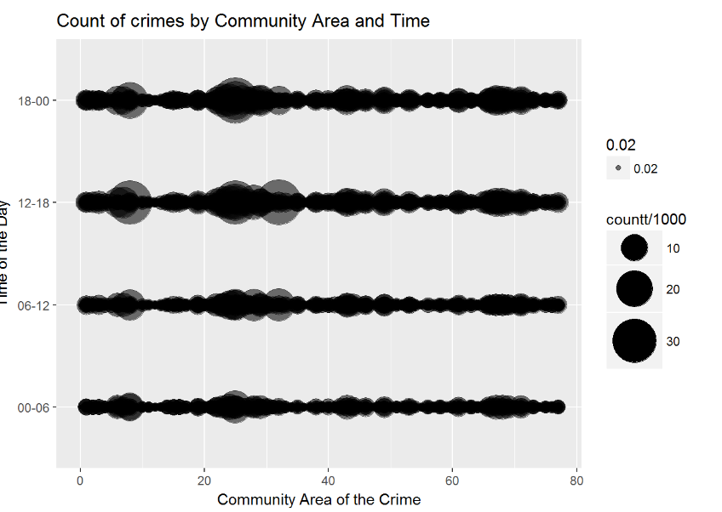
Data Analysis
Crimes per Community Area and Time
Bubble graph for visualization of the factors : Place, Time, Rate (# of crimes) and Type of Crimes.
The above graph represents the occurrence of crime based on the time interval and the community area (i.e. location). We can further improvise the visualization by adding the type of crime along with the factors considered in the above graph.
The above graph, represents the types of crime, the rate of crime(i.e. # of crimes), the time interval and the community area. For the decision makers this graph serves as an important factor. The graph shows significant intensity of the crimes between the interval of the communities from 20 to 30. Our previous graphs (A) and (B) indicates that the community that suffers maximum crime is the community area 25. On further analytics, the time intervals and the types of crime play an important role.

Slide 10

Deep Neural Nets

Slide 11
Deep Neural Nets were used for classification
Data after 2001 which includes about 1.5 Million Data points
Training – 70%
Test – 30%
Trend line depicting Number of Crimes per year (2001 to Present) (Crime versus Year)

Slide 12
Training
Label Encoding – 33 Labels
Optimizer – Adam
Learning Rate – 0.001
Hidden Layer 2
Activation Function – ReLu

Slide 13
Evaluation
Estimator | Accuracy (%) | AUC
DNNClassifier | 84.25 | 0.833
SVM | 67.01 | 0.5052
6-fold Cross Validation on DNN estimator | 79.03 | --

Slide 14
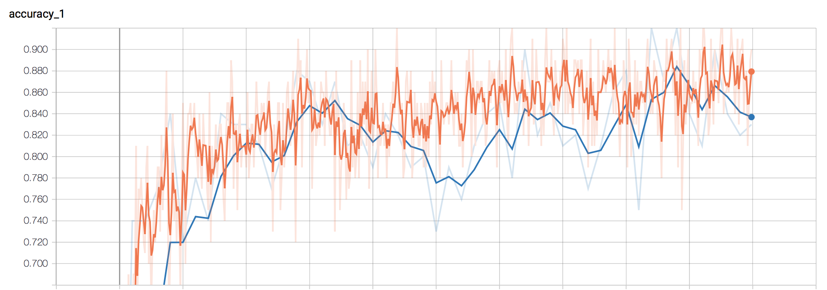

Slide 15
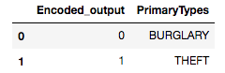
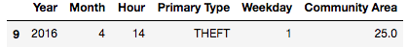
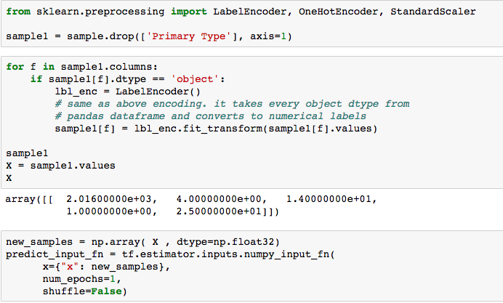
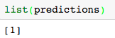
Input Sample
Prediction - Calculation
Prediction - Output

Slide 16

Conclusion

Slide 17

Conclusion
The Model can predict the crime based on time of the day, Month and Location Description

Slide 18

Future Points
User Interface
Build model based on Spacial, Temporal and Environments context that includes data collection from demographic, housing, economic, education, weather, and image data.

Slide 19


Slide 20


